Slide 1
Direct Manipulation and Virtual Environments
Sanjog Sigdel (57)
Computer Science, KU
12 July, 2015

Slide 2
CONTENTS:
Fundamental Principles
Direct Manipulation Examples
Discussion on Direct Manipulation
3D Interfaces
Teleoperation
Virtual and Augmented Realit

Slide 3
Fundamental Principles
one sees an advantage for discovery that is greatest when they express the exact nature of a thing briefly and, as it were, picture it; then, indeed, the labor of thought is wonderfully diminished. -Leibniz, May 1968
Continuous visibility of objects and actions of interest, with meaningful visual metaphor
Pointing or other physical actions on objects of interest, instead of typed commands

Slide 4
Attributes of Direct Manipulation
Novices can learn quickly, possibly by demonstration
Experts can work with high performance, define new features
High retention in intermediate users
Error messages rarely needed
Users get immediate feedback, can change undesirable actions or directions quickly
Users experience less anxiety
Users feel in control
A feeling that the system is somehow “natural”

Slide 5
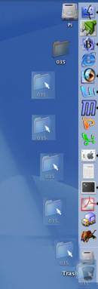
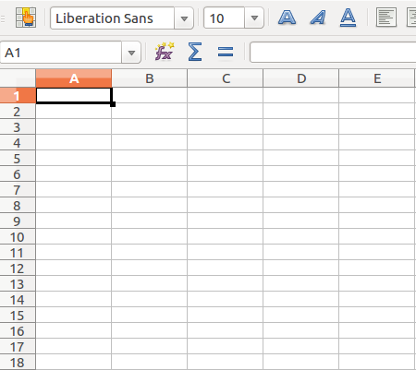
Examples:

Slide 6
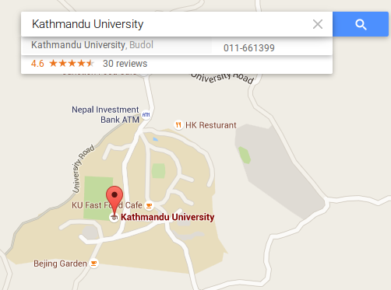
Examples(Contd…)

Slide 7
Examples(Contd…)
Driving a car
Steering wheel, pedals, windshield can be thought of as direct manipulation interface
Imagine how hard it would be to drive if done by typing in commands?
Spatial Data Management
First system based off idea by Nicholas Negroponte at MIT
Users could zoom in on colour-display of the world
ArcGIS by ESRI
Popular geographic-information system
Map-related information

Slide 8
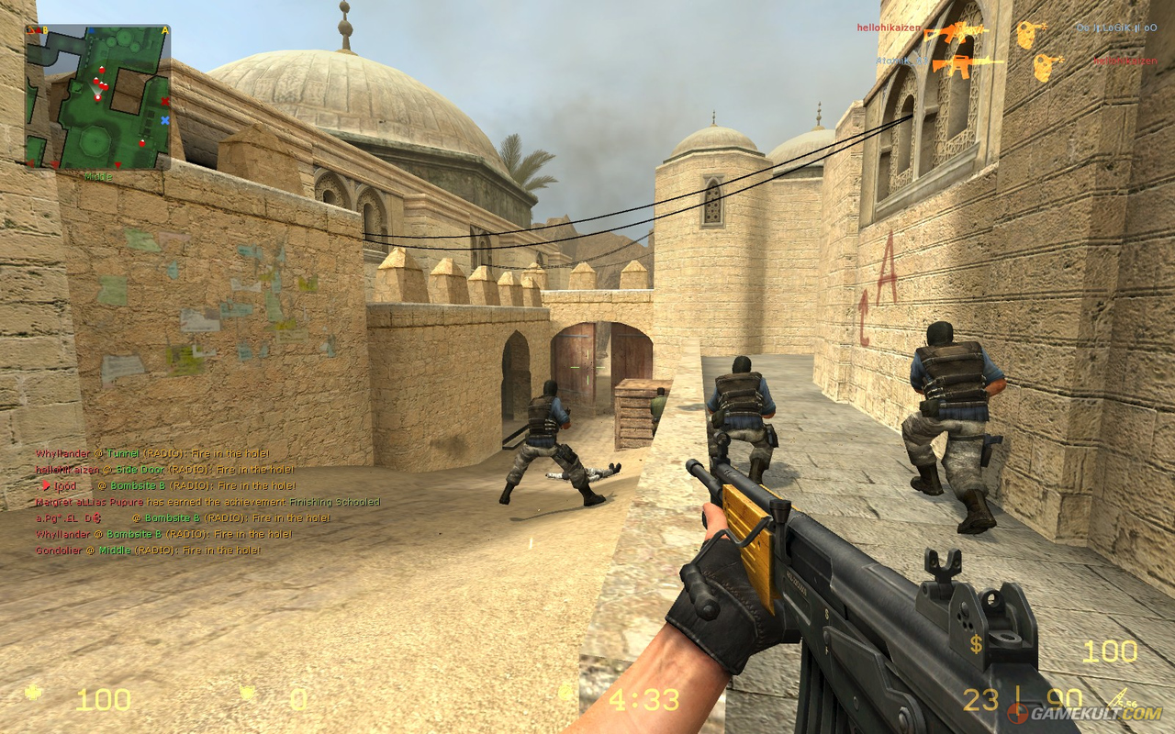

Examples(Contd…)

Slide 9
Examples(Contd…)
Video games
Probably the most commercially successful application of direct manipulation
Watching someone play is sufficient training!
Now on consoles, mobile platforms, smartphones, tablets, PC, 3D graphics, multiplayer online play, etc.
Computer-aided design (CAD)
Mechanical Engineering, automobiles, aircraft, electronic circuitry
e.g. On screen circuit schematic

Slide 10
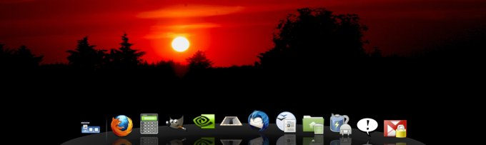
Examples(Contd…)
Airline reservation systems / QFX TICKET RESERVATION SYSTEM
Draggable Screens, Touch Screens

Slide 11
Direct Manipulation Discussions
SO WHAT IS THE FUTURE ?
Virtual reality
Ubiquitous computing
Augmented reality

Slide 12
Direct Manipulation Discussions
Principle of Virtuality “A Representation of reality which can be manipulated” (TED NELSON, 1980)
“feeling of involvement directly with a world of objects rather than of communicating with an intermediary” (Hutchins, 1986)
PROBLEMS
Screen Size is too small
Difficulty in pointing the icons
Problem in reading the contents
Can the right metaphor be found?
Results in slow performance of system
Hard to implement dynamic contents on web

Slide 13
3D INTERFACES
Problems with 3D Interfaces
Disorienting navigation
Complex user actions
Slow performance

Slide 14
Confusion / Disorientation
If users are presented with too many options or a distracting and complex design which requires complex user actions it causes:
confusion on what to next
problem in efficiency
it can lead to other emotional states, such as frustration.

Slide 15
3D Interfaces( Contd…)
3D interfaces that succeed:
● Medical imagery
● Architectural drawing
● Scientific simulations
Discussions on 3D Interfaces
Can Perform Slow
3D Highlights to 2D interface can be a distraction
3D games are very successful

Slide 16
TELEOPERATION
The electronic remote control of machines
Teleoperation uses:
● Manufacturing
● Surgery
● Flying airplanes
● Steering vehicles
Examples: Manufacturing of microprocessors, working mechanism of robots on car manufacturing company, Robotic surgery(robots doing brain surgery), Telepathology(Pathologist looks at tissue under remote microscope), Virtual colonoscopy (CT scan, 3D model generation),
supervisory control
● Human issues instructions, computer carries it out without interference
e.g. Mars landers, telemedicine(transportation of medicine through air drones), launching a missile

Slide 17
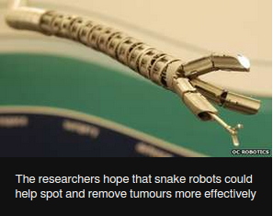
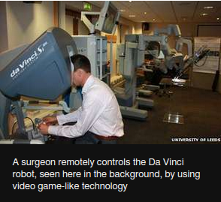
Teleoperation(Contd…)

Slide 18
Teleoperation(Contd…)
Potential teleoperation problems:
Slow responses
Transmission delay, operation delay
Incomplete feedback
Unanticipated interferences
Increased likelihood of breakdowns
More complex error recovery procedures

Slide 19
Virtual & Augmented Reality
Virtual reality
simulation of physical presence in real world or virtual environments
Augmented Reality
Augmenting a direct or indirect view of a real world environment with computationally generated information – sound, video, text, etc

Slide 20
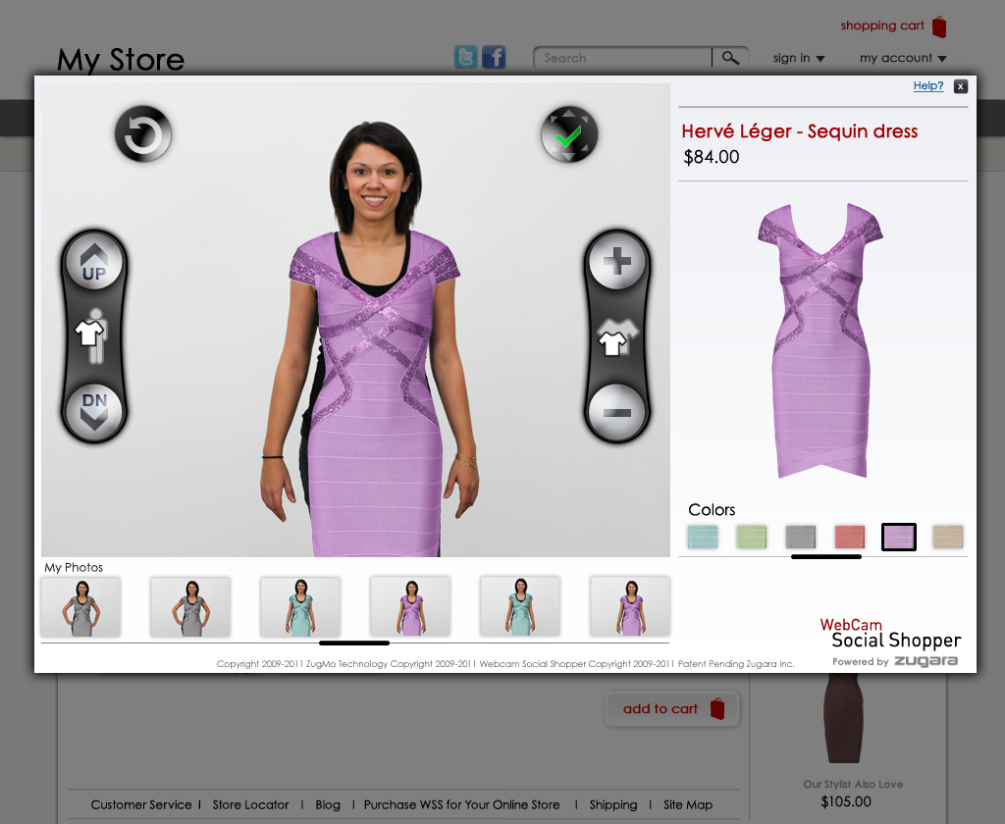
Virtual & Augmented Reality

Slide 21
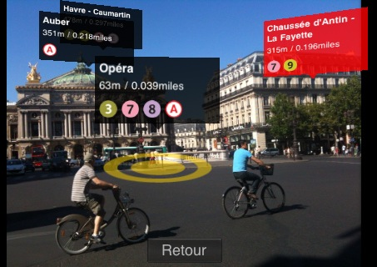
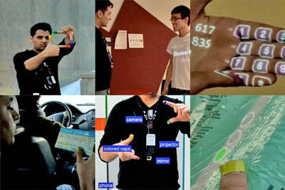
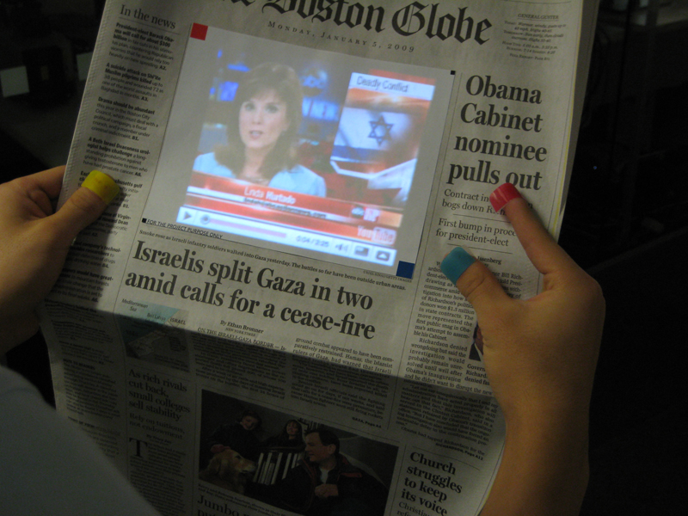

Slide 22
Virtual & Augmented Reality(COntd…)
Hydraulic jacks
Choreographed sounds
Simulated cockpits, control panels
Flight Simulator
Seems expensive but are actually cheaper than reality.
“telepresence” combination of teleoperation using virtual and augmented reality

Slide 23
Virtual & Augmented Reality(COntd…)
Concerns with Virtual Reality:
Visual display
Head-position sensing
Hand-position sensing
Hand-held manipulatives
Force feedback and haptics
Sound input and output
Other sensations
Collaborative and competitive virtual environment

Slide 24

References
Designing the User Interface: Strategies for Effective Human-Computer Interaction / 5th edition, by Ben Schneiderman & Catherine Plaisant (2010)
Nelson, Ted, Interacive systems and design of virtuality, Creative Computing, 6, 11, (November 1980)
THANK YOU
TIME’S UP

